Slide 2
What is Cluster Analysis?
Given a set of objects, place them in groups such that the objects in a group are similar (or related) to one another and different from (or unrelated to) the objects in other groups
Inter-cluster distances are maximized
Intra-cluster distances are minimized
Notes:
psychology and other social sciences, biology,
statistics, pattern recognition, information retrieval, machine learning, and
data mining.
unsupervised classification.
Also, while the terms segmentation and partitioning are sometimes
used as synonyms for clustering, these terms are frequently used for approaches
outside the traditional bounds of cluster analysis. For example, the term
partitioning is often used in connection with techniques that divide graphs into
subgraphs and that are not strongly connected to clustering.
Segmentation
often refers to the division of data into groups using simple techniques; e.g.,
an image can be split into segments based only on pixel intensity and color, or
people can be divided into groups based on their income. Nonetheless, some
work in graph partitioning and in image and market segmentation is related
to cluster analysis.

Slide 3
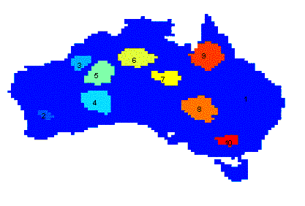
Applications of Cluster Analysis
Understanding
Group related documents for browsing, group genes and proteins that have similar functionality, or group stocks with similar price fluctuations
Summarization
Reduce the size of large data sets
Clustering precipitation in Australia

Slide 4
Notion of a Cluster can be Ambiguous
How many clusters?
Six Clusters
Two Clusters
Four Clusters

Slide 5
Types of Clusterings
A clustering is a set of clusters
Important distinction between hierarchical and partitional sets of clusters
Partitional Clustering
A division of data objects into non-overlapping subsets (clusters)
Hierarchical clustering
A set of nested clusters organized as a hierarchical tree

Slide 6
Partitional Clustering
Original Points
A Partitional Clustering

Slide 7
Hierarchical Clustering
Traditional Hierarchical Clustering
Traditional Dendrogram
Non-traditional Hierarchical Clustering
Non-traditional Dendrogram

Slide 8
Other Distinctions Between Sets of Clusters
Exclusive versus non-exclusive
In non-exclusive clusterings, points may belong to multiple clusters.
Can belong to multiple classes or could be ‘border’ points
Fuzzy clustering (one type of non-exclusive)
In fuzzy clustering, a point belongs to every cluster with some weight between 0 and 1
Weights must sum to 1
Probabilistic clustering has similar characteristics
Partial versus complete
In some cases, we only want to cluster some of the data
Notes:
For instance, a person at a university can be
both an enrolled student and an employee of the university
A non-exclusive
clustering is also often used when, for example, an object is “between” two
or more clusters and could reasonably be assigned to any of these clusters.
Imagine a point halfway between two of the clusters of Figure 8.1. Rather
than make a somewhat arbitrary assignment of the object to a single cluster,
it is placed in all of the “equally good” clusters.
In a fuzzy clustering, every object belongs to every cluster with a membership
weight that is between 0 (absolutely doesn’t belong) and 1 (absolutely
belongs). In other words, clusters are treated as fuzzy sets. (Mathematically,
a fuzzy set is one in which an object belongs to any set with a weight that
is between 0 and 1. In fuzzy clustering, we often impose the additional constraint
that the sum of the weights for each object must equal 1.) Similarly,
probabilistic clustering techniques compute the probability with which each
point belongs to each cluster, and these probabilities must also sum to 1.

